Slide 1
Project- Malignant Comment Classifier
Aarti A Ambhore

Slide 2
Problem Statement:
Social media platforms are the most prominent grounds for toxic behaviour.
There has been a remarkable increase in the cases of cyberbullying and trolls on various social media platforms.
Internet comments are bastions of hatred and vitriol. While online anonymity has provided a new outlet for aggression and hate speech, machine learning can be used to fight it.
Although researchers have found that hate is a problem across multiple platforms, there is a lack of models for online hate detection.
Our goal is to build a prototype of online hate and abuse comment classifier which can used to classify hate and offensive comments so that it can be controlled and restricted from spreading hatred and cyberbullying.

Slide 3
Dataset Description:
The data set contains the training set, which has approximately 1,59,000 samples and the test set which contains nearly 1,53,000 samples. All the data samples contain 8 fields which includes ‘Id’, ‘Comments’, ‘Malignant’, ‘Highly malignant’, ‘Rude’, ‘Threat’, ‘Abuse’ and ‘Loathe’.
The label can be either 0 or 1, where 0 denotes a NO while 1 denotes a YES. There are various comments which have multiple labels. The first attribute is a unique ID associated with each comment.

Slide 4
The data set includes:
Malignant: It is the Label column, which includes values 0 and 1, denoting if the comment is malignant or not.
Highly Malignant: It denotes comments that are highly malignant and hurtful.
Rude: It denotes comments that are very rude and offensive.
Threat: It contains indication of the comments that are giving any threat to someone.
Abuse: It is for comments that are abusive in nature.
Loathe: It describes the comments which are hateful and loathing in nature.
ID: It includes unique Ids associated with each comment text given.
Comment text: This column contains the comments extracted from various social media platforms.

Slide 5
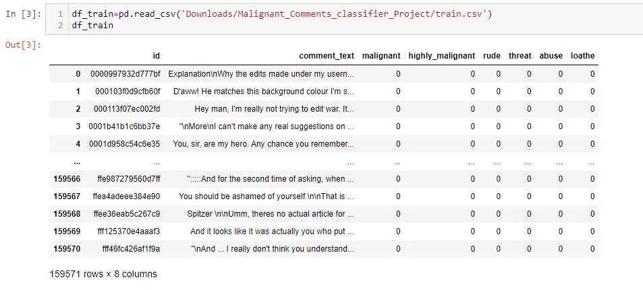
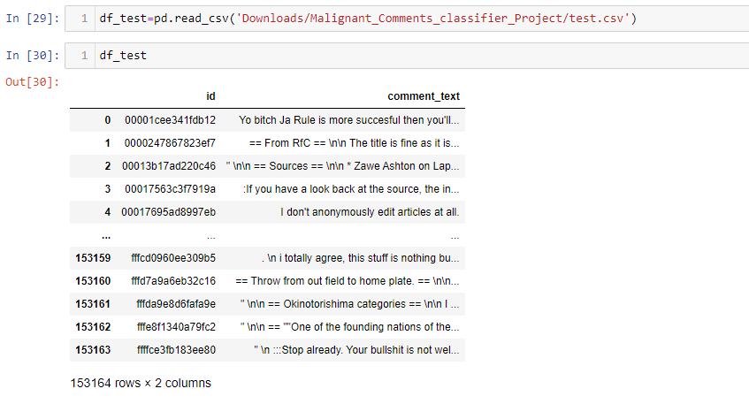
The given dataset is read as df_train and df_test :

Slide 6


Shape of train and test dataset:
Train data set contains 159571 rows and 8 columns
Test data set contains 153164 rows and 2 columns

Slide 7
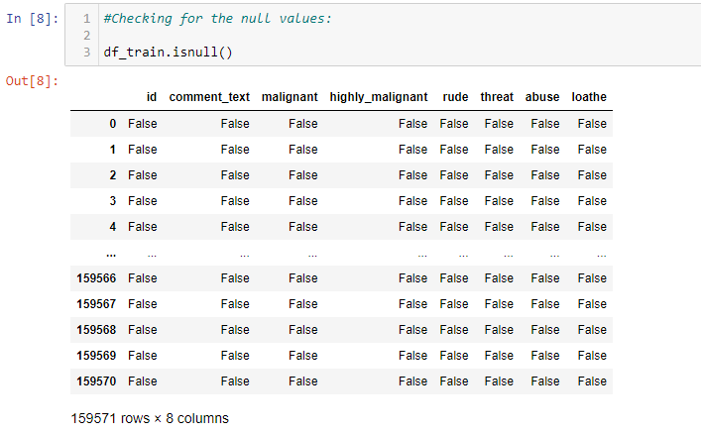
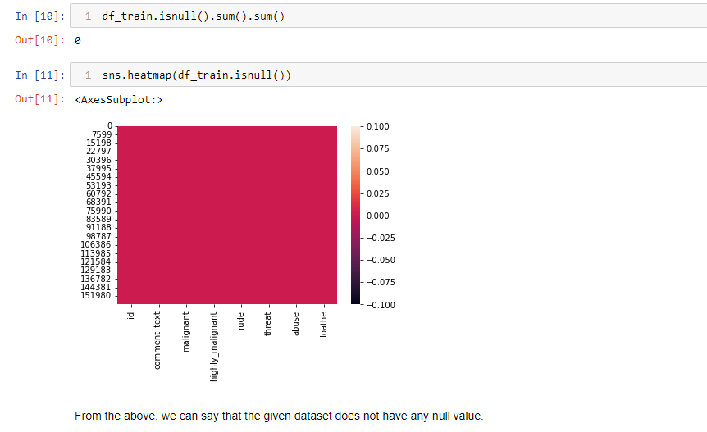
Checking for null values:
From the above we can say that there is no null value in train dataset.

Slide 8
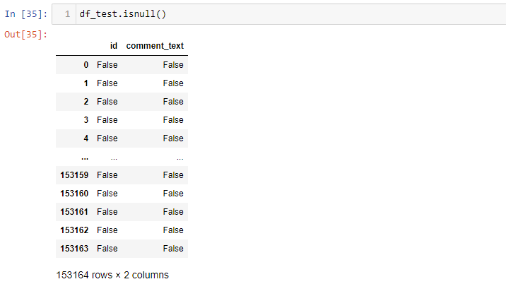
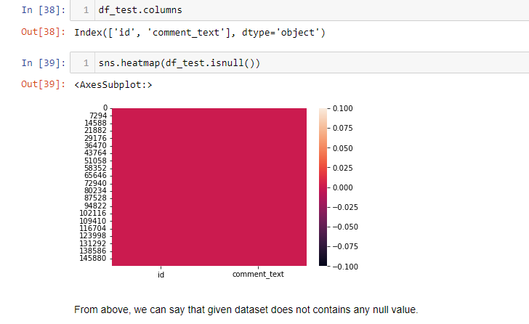
From above we can say that there is no null value in the test dataset.

Slide 9
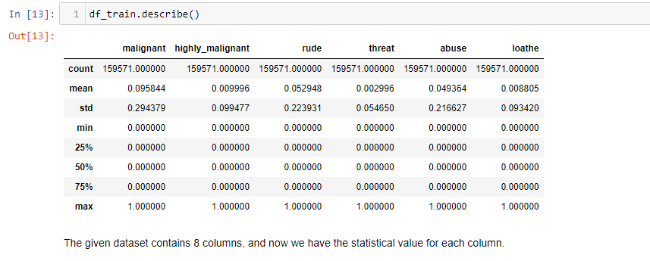
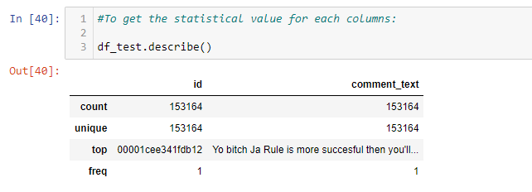
Statistical values for train and test data:

Slide 10
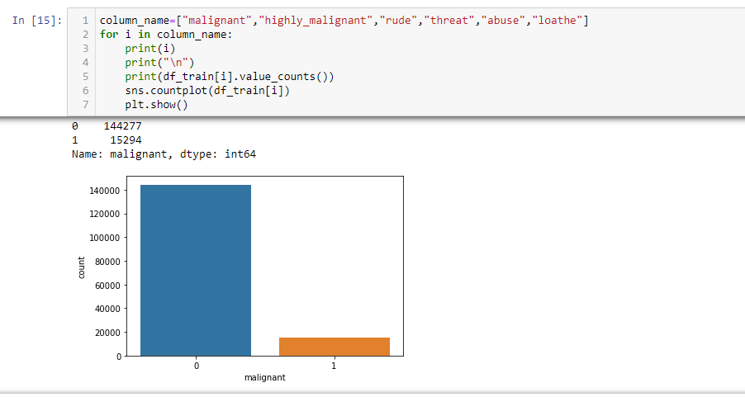
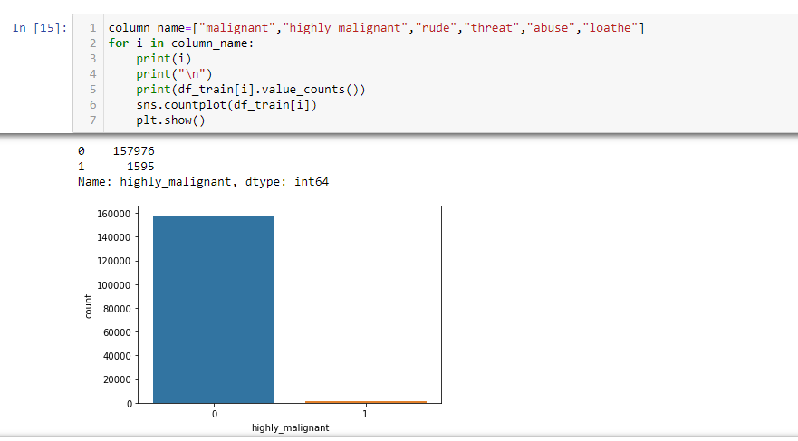
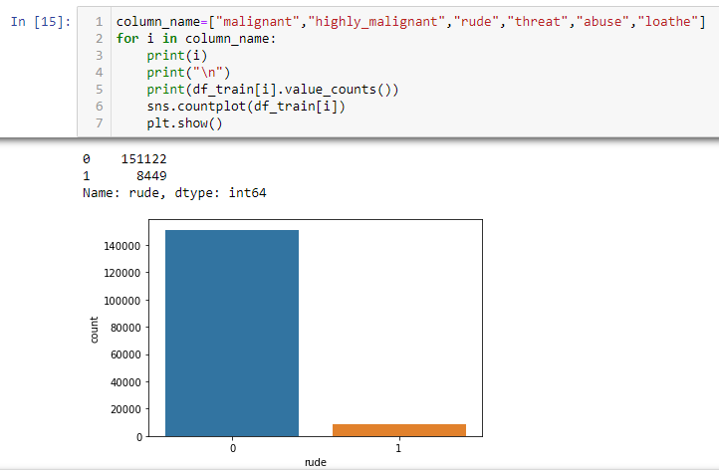

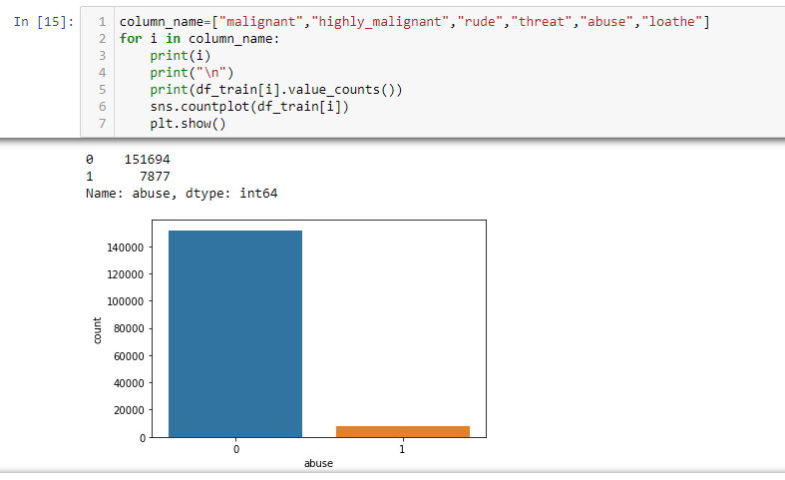

Visualization :

Slide 11
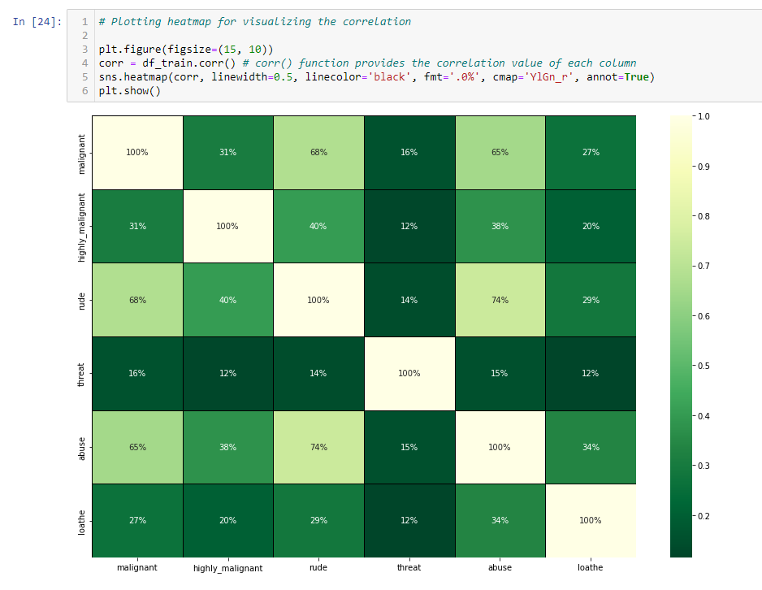
Correlation:

Slide 12
Machine learning models:
Decision Tree Classifier
Random Forest Classifier
Logistic Regression
Gradient Boosting Classifier
Ada Boost Classifier
KNeighbors Classifier
Out of these models the Random Forest Classifier model is the best fit model. Which is showing the accuracy about 95.72%.

Slide 13
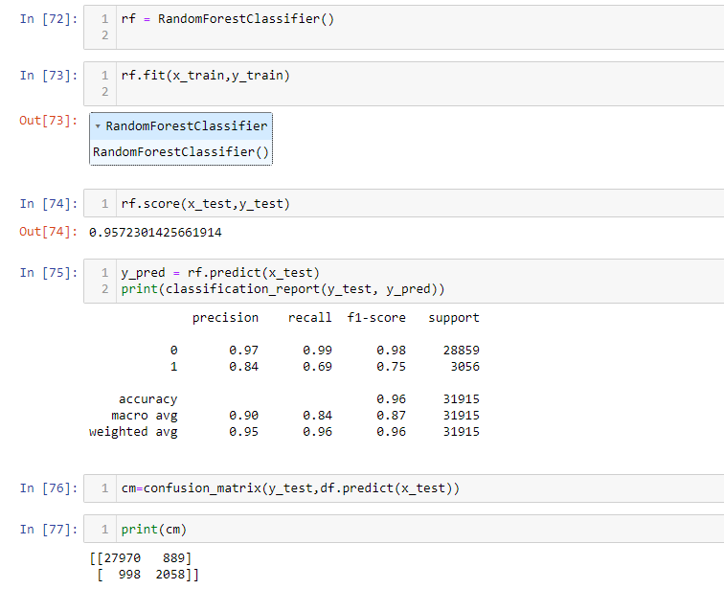
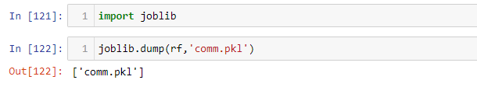
Saving the best fit model:
Random Forest Classifier is the best fit model with 96% of accuracy.

Slide 14
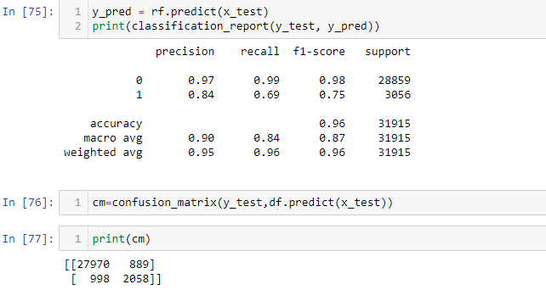
Result:
Random Forest Classifier model predict the best result for the given dataset.
The accuracy of this model is 95.72%.
The confusion matrix and classification report for the given model is given below:

Slide 15
Conclusion:
Key Findings and Conclusions of the Study:
I used various classification methods and out of all machine learning algorithm used, Random Forest classifier yields the best results.
These malignant comments classification can be used by social media companies to filter and classify some keywords as highly malignant and set their own policy going forward for the customers and other shareholders.

Slide 16
THANK YOU…

